Slide 1
Civil Rights Based Framework for Internet of Brazil and Civil Liability of Internet Providers for Online Copyright Infringement
Ph.D Prof. Rodrigo Vieira Costa

Slide 2
Regulation of the Internet in Brazil
Law and Internet
Digital Environment Regulatory Strategies
Self-Regulation in Cyberspace (Standards of conduct and ethics developed by the users – Softlaw – Free Software Movement – Declaration of the Independence of Cyberspace in 1996)
Private and commercial model of internet and intellectual property (hard law – WTO)
Principles (reasonableness and proportionality), open model and hard law rules

Slide 3
Brazilian Civil Rights for the Internet (Marco Civil Law of the Internet – MCI)
MCI
Principles, guarantees, rights and duties for the use of the Internet
Duties and liability of internet service providers
Legislative Process and Democratic Public Consultation on the Internet
Basic Principles
Freedom of expression
Network Neutrality
Access to information
Protection of privacy and personal data
Openness , cooperation and the participative nature of the network
The liability of the agents according their activities
Freedom of business models promoted on the internet

Slide 4
Liability of Internet Service Providers
Classification of Internet Providers according to Brazilian doctrine and jurisprudence (Superior Court of Justice)
Backbones
Internet access providers
Hosting providers
Information providers
Content providers
Internet search providers
* Internet service providers can offer services of different natures. However, the conceptual difference remains and is indispensable to the correct imputation of the liability inherent to each service provided.
Classification of Internet Providers according to the MCI
Internet connection providers
Internet applications providers

Slide 5
Art. 5º For the purposes of this Law, the following concepts apply:
V – internet connection: the enabling of a terminal for sending and receiving data packets over the Internet, by assigning or by authenticating an IP address;
[…]
VII – internet applications: a set of functionalities that can be accessed through a terminal connected to the Internet;

Slide 6
Liability of Internet Service Providers
Liability of internet providers for their own actions
Liability for any damages arising from content generated by third parties
* The provider of connection to internet shall not be liable for civil damages resulting from content generated by third parties.

Slide 7
Liability for any damages arising from content generated by third parties
Theses before the MCI
General exemption from liability of providers [based on Section 230 (c) (Protection for private blocking and screening of offensive material) of the Communications Act of 1934, introduced by the Communications Decency Act of 1996, but Internet Providers, pursuant to section 512 (d) of Digital Millenium Copyright Act, can be held liable for infringing copyrights if they do not promote the removal of illicit material and disabling access]
Strict liability based:
1) on the inherent risk of economic activity; or
2) on defect in the provision of the service according to the Code of Consumer Protection
Subjective liability
1) failure to remove infringing content after extrajudicial notice
2) failure to remove infringing content after an specific court order

Slide 8
Liability for any damages arising from content generated by third parties
Art. 19. In order to ensure freedom of expression and prevent censorship, the provider of internet applications can only be subject to civil liability for damages resulting from content generated by third parties if, after an specific court order, it does not take any steps to, within the framework of their service and within the time stated in the order, make unavailable the content that was identified as being unlawful, unless otherwise provided by law.

Slide 9
Superior Court of Justice
With MCI, the initial term of the application provider's liability was delayed in time, starting only after judicial notification from the application provider. The rule to be used for the resolution of disputes must take into account the moment the harmful act occurs or, in other words, when the infringing contents were published:
for events that occurred prior to the entry into force of the MCI, the jurisprudence of Superior Court must be obeyed (according to which the application provider became jointly liable as soon as it was notified in any way by the victim);
(ii) after the entry into force of Law 12.965 / 2014, the initial term of responsibility for the joint liability of the application provider, pursuant to art. 19 of the MCI, it is the moment of the judicial notice that orders the removal of certain content from the Internet.

Slide 10
And the copyright?

Slide 11
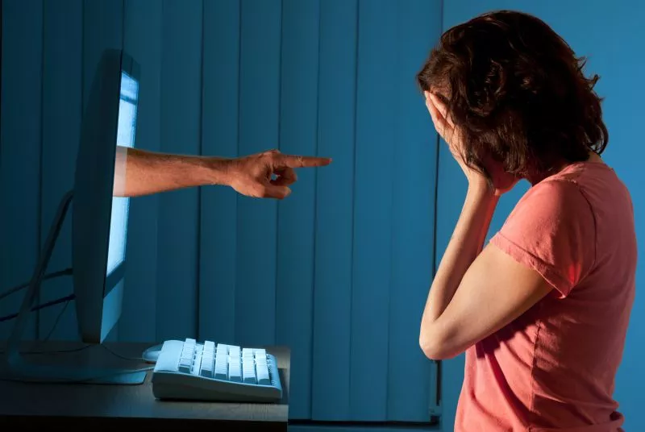
Exceptions to the liability regime of for any damages arising from content generated by third parties
Revenge Porn
Art. 21. The internet application provider that makes third party generated content available shall be held liable for the breach of privacy arising from the disclosure of images, videos and other materials containing nudity or sexual activities of a private nature, without the authorization of the participants, when, after receipt of notice by the participant or his/hers legal representative, refrains from removing, in a diligent manner, within its own technical limitations, such content.
Sole Paragraph. The notice set forth above must contain sufficient elements that allow the specific identification of the material said to violate the right to privacy of the participant-user and the confirmation of the legitimacy of the party presenting the request.

Slide 12
Exceptions to the liability regime of for any damages arising from content generated by third parties
Copyright
Art. 19. […].
§ 2. The implementation of the provisions of this article for infringement of copyright or related rights is subject to a specific legal provision, which must respect freedom of speech and other guarantees provided for in art. 5o of the Federal Constitution.
Art. 31. Until the entry into force of specific law provided for in § 2º of art. 19, the liability of the internet applications provider for damages arising from content generated by third parties, in case of copyright or related rights infringement, shall continue to be governed by applicable copyright legislation in force, at the time of entry into force of this Law.

Slide 13
What does the Brazilian Copyright Law say?
105. The transmission and retransmission by any means or process and the communication to the public of literary, artistic and scientific works, performances and phonograms carried out in violation of the rights of the owners shall be immediately discontinued or interrupted by the competent judicial authority, without prejudice to a daily coercive fine for non-observance and such other indemnities as may be applicable, and without regard to the applicable criminal sanctions. Where the offender is found guilty of recidivism in the infringement of the rights of owners of authors’ rights or neighboring rights, the amount of the fine may be doubled.

Slide 14
What were the proposals for the removal of copyright infringement content in the discussion of the Brazilian Copyright Law Reform?

Slide 15
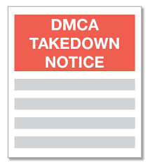
Notice and take down
Notice and notice
(counter notification)
Judicial notice and take down

Slide 16
What were the proposals for the removal of content for copyright infringement in the digital environment in MCI discussion?
In the public consultation phase of the MCI, there were similar discussions to the Reform of the Copyright Law in Brazil. There were disputes between the notice-and-take down, the notice-and-notice and the judicial-notice-and-takedown.
The lobby of cultural industries, media companies and copyright holders prevailed in excluding MCI from any prediction mechanism for removal content for copyright infringement and provider liability.

Slide 17
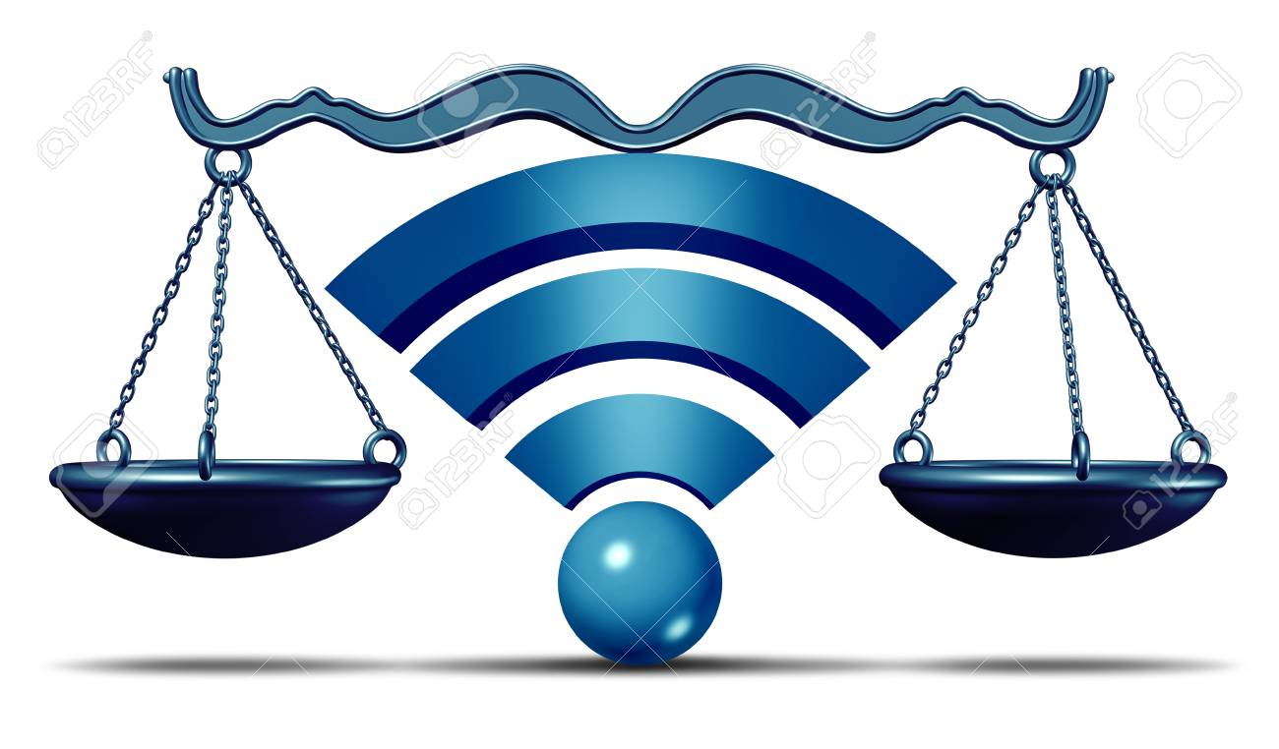
What the Brazilian courts say?

Slide 18
Superior Court of Justice
Only one case in Special Appeal (REsp. 1.512.647-MG) on fact about copyrigth occurred before the MCI.
In the first instance and second instance appeal, Google, owner of the Orkut social network, was held liable for the existence of a virtual community that illegally shared videos of courses of a film company for violation of the Brazilian Copyright Law, after extrajudicial notice in which the provider did not took action.
Before the MCI, the liability of the provider was subjective and verified after inertia in the case of extrajudicial notice for copyright infringement.
The Superior Court rejected the provider's liability, applying the MCI a fact before to the enactment of the law, for two reasons:
there was no contributory liability for the provider to encourage or induce illegal against intellectual property;
b) there was no vicarious liability provider in order to profit from unlawful acts by third parties and benefit by refusing to exercise power control to limit the damage.

Slide 19
Other legal cases in Brazil (2017-2018 – MCI Observatory)
First Instance
São Paulo (1007630-97.2017.8.26.0001 – Judicial sentence) – The terms of use of the application providers can not be invoked arbitrarily for removal of content that allegedly infringe copyright, especially when the act is not preceded by notice of the social network.
São Paulo (11118932-33.2014.8.26.0100 – Judicial sentence) – In the opposite direction, the Judicial sentence considered extrajudicial notice a mechanism sufficient for the application provider to take steps to provide the required information on access records to identify a channel responsible for video that taught others to violate DRMs, contrary to Article 15 of the MCI.

Slide 20
Other legal cases in Brazil (2017-2018 – MCI Observatory)
2) Second instance appeal
Santa Catarina (Appeals 0000412-86.2016.8.24.0175 e 4012221-45.2016.8.24.0000) – Copyright infringement and parody
Parodies are exceptions to copyright. They are legally envisaged as forms of exercising freedom of artistic expression and humor. The application provider can not take the internet parody video only because of extrajudicial notice representatives of copyright holders parodied music based on their terms of use.
The removal of content for copyright infringement without a court order is contrary to Article 19 of the MCI.

Slide 21
Conclusions
The MCI did not specifically address the protection of intellectual property but removed the application of the notice and takedown form in proceedings involving liability for infringements of contents protected by Intellectual Property Rights in relationships established on the Internet.
The decision to maintain or remove content copyright infringement after extrajudicial notice based on the terms of use of the application provider is a liberality for which it may be held liable. The Article 19 of the MCI is a guarantee of the application providers.

Slide 22
PhD Prof. Rodrigo Vieira
rodrigo.vieira@ufersa.edu.br
rodrigo.vieira@direitosculturais.com.br
www.gedai.com.br
www.direitosculturais.com.br

